Slide 1
Atari Air Raid
Rihab Alzurkani

Slide 2
In this project we are solving the OpenAI gym - AirRaid problem using suitable RL algorthims
I use DQN
Agenda
20XX
Sample Footer Text

Slide 3
Introduction
In the AirRaid environment , the task is to control a ship that can move sideways.We have to protect two buildings one on the right and second on the left of the screen from the flying saucers that are trying to drop bombs on them.
The action space is discrete with up to 18 possible actions. The observation space consists of three types: "rgb", "grayscale" and "ram". For this project, I choose the "ram" (`ALE/AirRaid-ram-v5`).
20XX

Slide 4
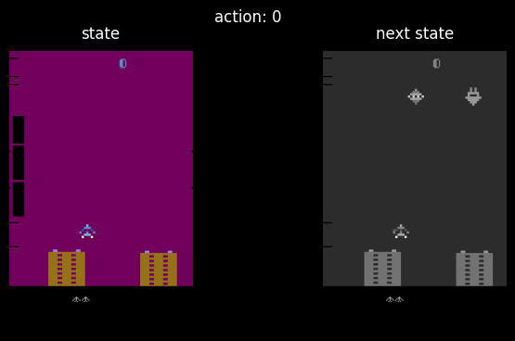
Environment
ALE/AirRaid-v5
Observation Type : ram
Initial state dimension: (250, 160, 3)
Observation space: Action space: Discrete(6)

Slide 5
ALE/AirRaid-v5
20XX
Sample Footer Text

Slide 6
Choosing Air Raid v5 (Arcade Learning Environment)
Air Raid is last standard follow the updated GymAPI and modern best practice . It provide more compatibility with available reinforcement learning frameworks.
Enhenced Stochastic version5 introduce slight variability in frame skipping and gameplay , making it more challangable and promopbting agent training.
Benchmark Suitability:Air Raid provide mix of reactive and stragitic gameplay, ideal for testing and benckmark different environments.
Complexity and Learning:The environment is relatively simple visuals combined with complex enemy behaviour this make it best choice for developing agents that can learn targeting ,evasion and optimal shooting.
RAM and Pixel Modes:Offer more flexibility for raw pixels input or direct Ram access it can reach the objectives and computational resources.
All of those features make it best choice for testing roboust RL models in controlled challenging setting.

Slide 7
Starting State
Initial State: At the beginning of an episode, the game is reset to a consistent initial state where the player's ship is positioned at the bottom of the screen. The player starts with a fixed number of lives, typically three or a similar amount defined by the game.
RAM Observations: If using the RAM version (AirRaid-ram-v4 or AirRaid-ram-v5), the initial state is represented by a 128-byte array that reflects the state of the game's RAM at the start. This RAM state includes information such as the player's position, enemy positions, game score, and other in-game variables.
Episode Termination
Termination Conditions:
  Loss of Lives: The episode ends when the player loses all available lives. This condition occurs after being hit by enemies or bombs a certain number of times (usually equivalent to the number of lives available).
  Game-Specific Triggers: In some cases, the episode may end due to in-game events such as completing a level or reaching an unreachable game state (e.g., in certain versions, the game may end if the player achieves the maximum score).
  Time Limits: In environments using the gym wrapper, episodes might also be terminated based on a step limit set by the user or environment configuration.

Slide 8
Versions Difference
Air Raid Version-5:
This version introduced with Gym and uses the latest API , this providing enhanced compatibility with modern Gym standards and potentially includes frame-skip configurations or stochastics effects for more varied gameplay. This version terminated with slightly different behaviour due to the new additional elements.
Air Raid Version-4:
This version runs deterministically , meaning the actions and their effects are consistent. The episode terminates predicably when the predefined conditions are met .

Slide 9
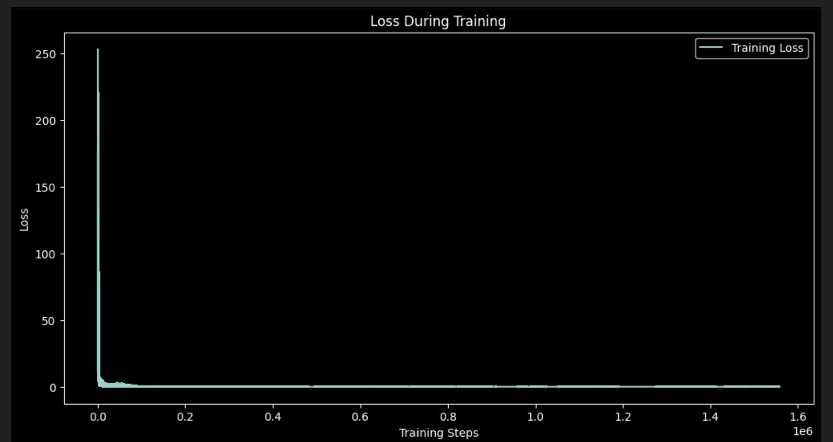

Slide 10
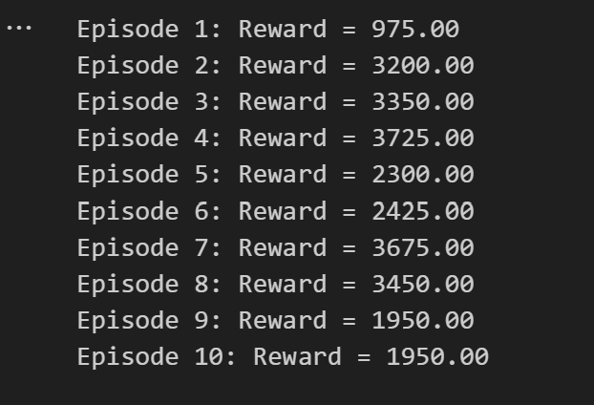

Slide 11
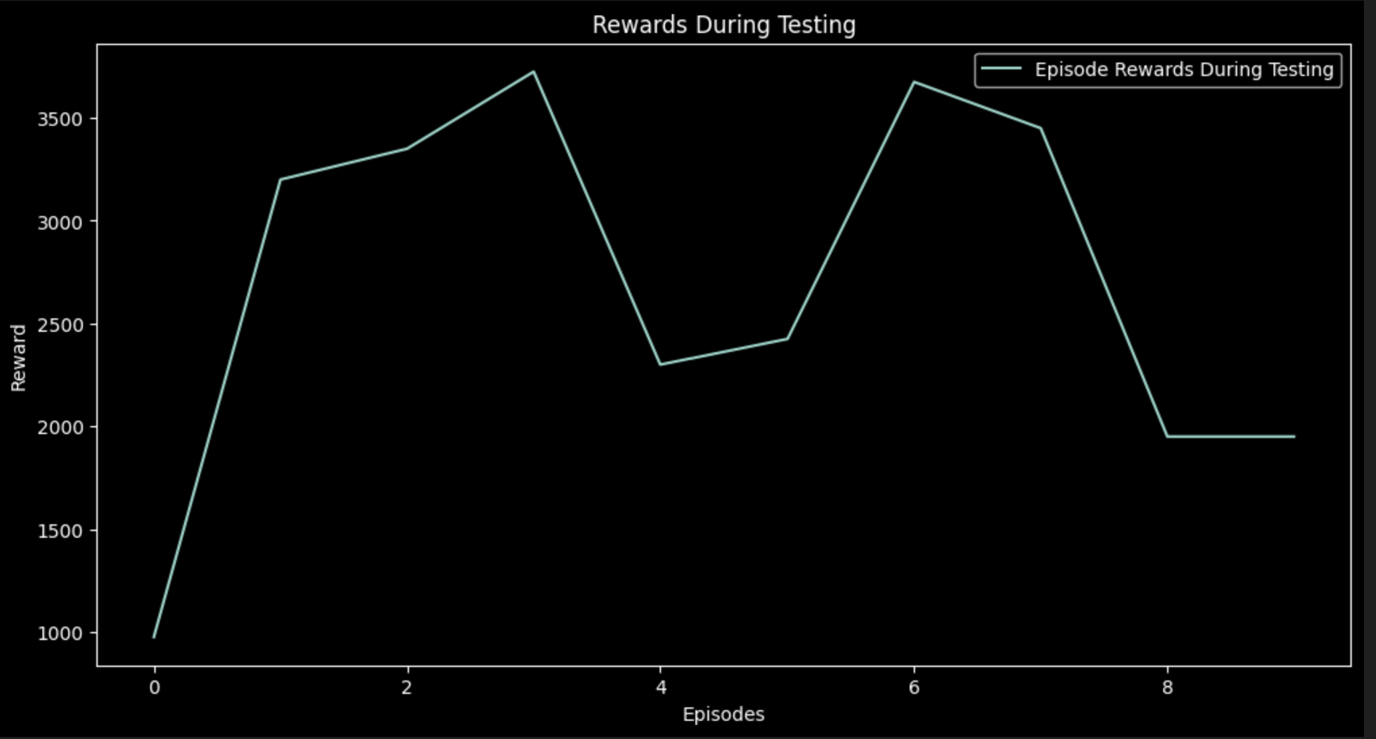

Slide 12
Conclusion
Training Loss Analysis: The initial training phase shows a steep decrease in loss, indicating that the model learned quickly at the beginning. However, the flatline after the steep drop implies the model reached a stable state with minimal improvement.
Reward Performance: During testing, the rewards per episode indicate varied performance. While some episodes yielded high rewards, others showed a decline. This variability might suggest that the agent has learned effective strategies for certain states but still struggle across different scenarios.

Slide 13
Conclusion:
The DQN training appears effective initially, as evidenced by significant reward spikes and reduced loss. However, the fluctuation in rewards during testing suggests that the model might need further fine-tuning or improvements in exploration strategy, reward scaling, or network architecture to enhance stability across episodes.

